Slide 1
Variations of Turing Machines
S.Rajkumar
Assistant Professor
SCSE, VIT University
Vellore

Slide 2
Turing’s thesis:
Any computation carried out
by mechanical means
can be performed by a Turing Machine
(1930)

Slide 3
Computer Science Law:
A computation is mechanical
if and only if
it can be performed by a Turing Machine
There is no known model of computation
more powerful than Turing Machines

Slide 4
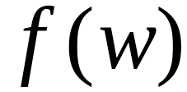
Definition of Algorithm:
An algorithm for function
is a
Turing Machine which computes

Slide 5
Algorithms are Turing Machines
When we say:
There exists an algorithm
We mean:
There exists a Turing Machine
that executes the algorithm

Slide 6
Variations of the
Turing Machine

Slide 7




The Standard Model
Infinite Tape
Read-Write Head
(Left or Right)
Control Unit
Deterministic

Slide 8
Variations of the Standard Model
Turing machines with:
Stay-Option
Semi-Infinite Tape
Off-Line
Multitape
Multidimensional
Nondeterministic

Slide 9
The variations form different
Turing Machine Classes
We want to prove:
Each Class has the same
power with the Standard Model

Slide 10
Same Power of two classes means:
Both classes of Turing machines accept
the same languages

Slide 11
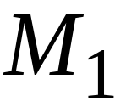
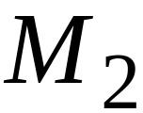
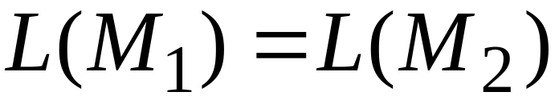
Same Power of two classes means:
For any machine of first class
there is a machine of second class
such that:
And vice-versa

Slide 12
Simulation:
a technique to prove same power
Simulate the machine of one class
with a machine of the other class
Second Class
Simulation Machine
First Class
Original Machine

Slide 13
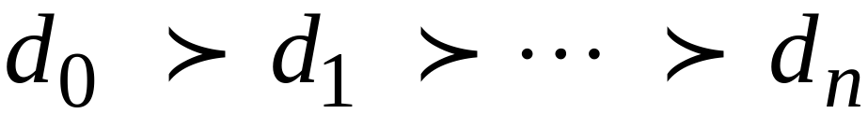
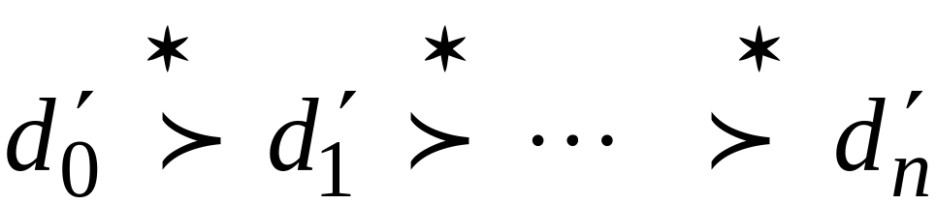
Configurations in the Original Machine
correspond to configurations
in the Simulation Machine
Original Machine:
Simulation Machine:

Slide 14
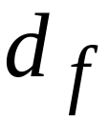
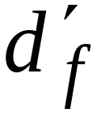
Final Configuration
Original Machine:
Simulation Machine:
The Simulation Machine
and the Original Machine
accept the same language

Slide 15
Turing Machines with Stay-Option
The head can stay in the same position
Left, Right, Stay
L,R,S: moves

Slide 16



Example:
Time 1
Time 2

Slide 17
Theorem:
Stay-Option Machines
have the same power with
Standard Turing machines

Slide 18
Proof:
Part 1: Stay-Option Machines
are at least as powerful as
Standard machines
Proof:
a Standard machine is also
a Stay-Option machine
(that never uses the S move)

Slide 19
Proof:
Part 2: Standard Machines
are at least as powerful as
Stay-Option machines
Proof:
a standard machine can simulate
a Stay-Option machine

Slide 20

Stay-Option Machine
Simulation in Standard Machine
Similar for Right moves

Slide 21



Stay-Option Machine
Simulation in Standard Machine
For every symbol

Slide 22
Example
Stay-Option Machine:
1
2
Simulation in Standard Machine:
1
2
3

Slide 23

Standard Machine--Multiple Track Tape
track 1
track 2
one symbol

Slide 24
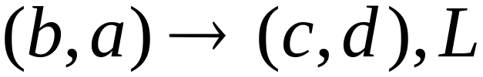
track 1
track 2
track 1
track 2

Slide 25

Semi-Infinite Tape
.........

Slide 26
Standard Turing machines simulate
Semi-infinite tape machines:
Trivial

Slide 27
Semi-infinite tape machines simulate
Standard Turing machines:
Standard machine
.........
.........
Semi-infinite tape machine
.........

Slide 28

Standard machine
.........
.........
reference point
Semi-infinite tape machine with two tracks
Right part
.........
Left part

Slide 29
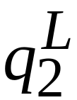
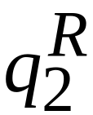
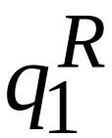
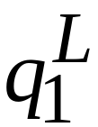
Standard machine
Semi-infinite tape machine
Left part
Right part

Slide 30

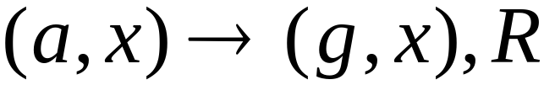
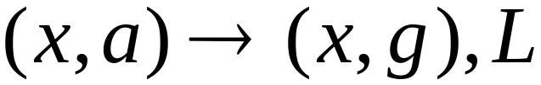
Standard machine
Semi-infinite tape machine
Right part
Left part
For all symbols

Slide 31
Time 1
Standard machine
.........
.........
Semi-infinite tape machine
Right part
.........
Left part

Slide 32

Time 2
Standard machine
.........
.........
Semi-infinite tape machine
Right part
.........
Left part

Slide 33
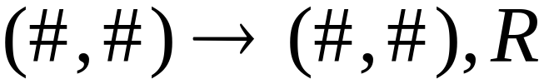
At the border:
Semi-infinite tape machine
Right part
Left part

Slide 34
Semi-infinite tape machine
Time 1
Right part
.........
Left part
Time 2
Right part
.........
Left part

Slide 35
Theorem:
Semi-infinite tape machines
have the same power with
Standard Turing machines

Slide 36
The Off-Line Machine
Input File
read-only
Control Unit
read-write
Tape

Slide 37
Off-line machines simulate
Standard Turing Machines:
Off-line machine:
1. Copy input file to tape
2. Continue computation as in
Standard Turing machine

Slide 38
Standard machine
Off-line machine
Input File
Tape
1. Copy input file to tape

Slide 39
Standard machine
Off-line machine
Input File
Tape
2. Do computations as in Turing machine

Slide 40
Standard Turing machines simulate
Off-line machines:
Use a Standard machine with four track tape
to keep track of
the Off-line input file and tape contents

Slide 41



Off-line Machine
Input File
Tape
Four track tape -- Standard Machine
Input File
head position
Tape
head position

Slide 42
Reference point
Input File
head position
Tape
head position
Repeat for each state transition:
Return to reference point
Find current input file symbol
Find current tape symbol
Make transition

Slide 43
Theorem:
Off-line machines
have the same power with
Stansard machines

Slide 44
Multitape Turing Machines
Control unit
Tape 1
Tape 2
Input

Slide 45
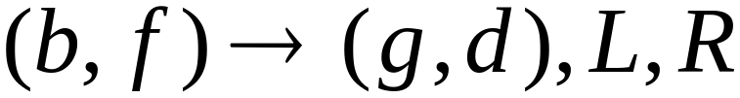
Tape 1
Time 1
Tape 2
Time 2

Slide 46
Multitape machines simulate
Standard Machines:
Use just one tape

Slide 47
Standard machines simulate
Multitape machines:
Standard machine:
Use a multi-track tape
A tape of the Multiple tape machine
corresponds to a pair of tracks

Slide 48

Multitape Machine
Tape 1
Tape 2
Standard machine with four track tape
Tape 1
head position
Tape 2
head position

Slide 49
Reference point
Tape 1
head position
Tape 2
head position
Repeat for each state transition:
Return to reference point
Find current symbol in Tape 1
Find current symbol in Tape 2
Make transition

Slide 50
Theorem:
Multi-tape machines
have the same power with
Standard Turing Machines

Slide 51
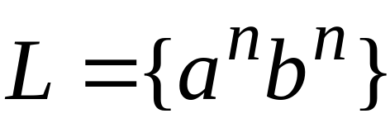
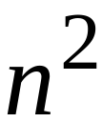

Same power doesn’t imply same speed:
Language
Acceptance Time
Standard machine
Two-tape machine

Slide 52

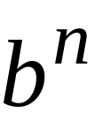

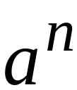
Standard machine:
Go back and forth times
Two-tape machine:
Copy to tape 2
( steps)
Leave on tape 1
( steps)
Compare tape 1 and tape 2
( steps)

Slide 53


MultiDimensional Turing Machines
Two-dimensional tape
MOVES: L,R,U,D
HEAD
U: up D: down
Position: +2, -1

Slide 54
Multidimensional machines simulate
Standard machines:
Use one dimension

Slide 55
Standard machines simulate
Multidimensional machines:
Standard machine:
Use a two track tape
Store symbols in track 1
Store coordinates in track 2

Slide 56


Two-dimensional machine
Standard Machine
symbols
coordinates

Slide 57
Standard machine:
Repeat for each transition
Update current symbol
Compute coordinates of next position
Go to new position

Slide 58
Theorem:
MultiDimensional Machines
have the same power
with Standard Turing Machines

Slide 59

NonDeterministic Turing Machines
Non Deterministic Choice

Slide 60
Time 0
Time 1
Choice 1
Choice 2

Slide 61

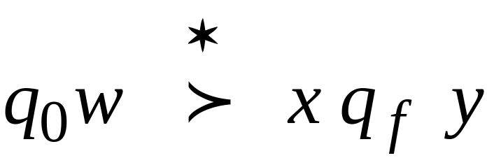
Input string is accepted if
this a possible computation
Initial configuration
Final Configuration
Final state

Slide 62
NonDeterministic Machines simulate
Standard (deterministic) Machines:
Every deterministic machine
is also a nondeterministic machine

Slide 63
Deterministic machines simulate
NonDeterministic machines:
Deterministic machine:
Keeps track of all possible computations

Slide 64




Non-Deterministic Choices
Computation 1

Slide 65
Non-Deterministic Choices
Computation 2

Slide 66
Simulation
Deterministic machine:
Keeps track of all possible computations
Stores computations in a
two-dimensional tape

Slide 67
NonDeterministic machine
Time 0
Deterministic machine
Computation 1

Slide 68

NonDeterministic machine
Time 1
Choice 1
Choice 2
Deterministic machine
Computation 1
Computation 2

Slide 69
Repeat
  Execute a step in each computation:
If there are two or more choices
in current computation:
1. Replicate configuration
2. Change the state in the replica

Slide 70
Theorem: NonDeterministic Machines
have the same power with
Deterministic machines

Slide 71
Remark:
The simulation in the Deterministic machine
takes time exponential time compared
to the NonDeterministic machine

